Slide 1
Figures – Chapter 17

Slide 2
Figure 17.1 Component characteristics
Component characteristic | Description
Standardized | Component standardization means that a component used in a CBSE process has to conform to a standard component model. This model may define component interfaces, component metadata, documentation, composition, and deployment.
Independent | A component should be independent—it should be possible to compose and deploy it without having to use other specific components. In situations where the component needs externally provided services, these should be explicitly set out in a ‘requires’ interface specification.
Composable | For a component to be composable, all external interactions must take place through publicly defined interfaces. In addition, it must provide external access to information about itself, such as its methods and attributes.
Deployable | To be deployable, a component has to be self-contained. It must be able to operate as a stand-alone entity on a component platform that provides an implementation of the component model. This usually means that the component is binary and does not have to be compiled before it is deployed. If a component is implemented as a service, it does not have to be deployed by a user of a component. Rather, it is deployed by the service provider.
Documented | Components have to be fully documented so that potential users can decide whether or not the components meet their needs. The syntax and, ideally, the semantics of all component interfaces should be specified.

Slide 3

Figure 17.2 Component interfaces

Slide 4
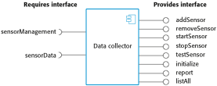
Figure 17.3 A model of a data collector component

Slide 5
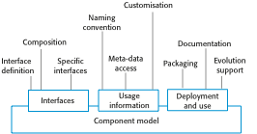
Figure 17.4 Basic elements of a component model

Slide 6
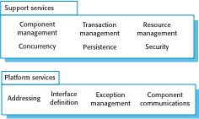
Figure 17.5 Middleware services defined in a component model

Slide 7
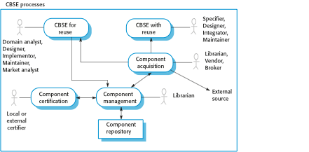
Figure 17.6 CBSE processes

Slide 8
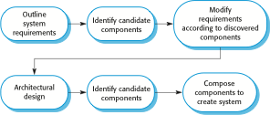
Figure 17.7 CBSE with reuse

Slide 9

Figure 17.8 The component identification process

Slide 10
Figure 17.9 An example of validation failure with reused software
The Ariane 5 launcher failure
While developing the Ariane 5 space launcher, the designers decided to reuse the inertial reference software that had performed successfully in the Ariane 4 launcher. The inertial reference software maintains the stability of the rocket. They decided to reuse this without change (as you would do with components), although it included additional functionality that was not required in Ariane 5.
In the first launch of Ariane 5, the inertial navigation software failed and the rocket could not be controlled. Ground controllers instructed the launcher to self-destruct and the rocket and its payload were destroyed. The cause of the problem was an unhandled exception when a conversion of a fixed-point number to an integer resulted in a numeric overflow. This caused the run-time system to shut down the inertial reference system and launcher stability could not be maintained. The fault had never occurred in Ariane 4 because it had less powerful engines and the value that was converted could not be large enough for the conversion to overflow.
The fault occurred in code that was not required for Ariane 5. The validation tests for the reused software were based on Ariane 5 requirements. Because there were no requirements for the function that failed, no tests were developed. Consequently, the problem with the software was never discovered during launch simulation tests.

Slide 11
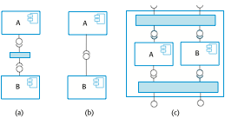
Figure 17.10 Types of component composition

Slide 12
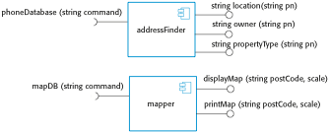
Figure 17.11 Components with incompatible interfaces

Slide 13

Figure 17.12 An adaptor linking a data collector and a sensor

Slide 14

Figure 17.13 Photo library composition

Slide 15
Figure 17.14 The OCL description of the Photo Library interface
-- The context keyword names the component to which the conditions apply
context addItem
-- The preconditions specify what must be true before execution of addItem
pre: PhotoLibrary.libSize() > 0
PhotoLibrary.retrieve(pid) = null
-- The postconditions specify what is true after execution
post:libSize () = libSize()@pre + 1
PhotoLibrary.retrieve(pid) = p
PhotoLibrary.catEntry(pid) = photodesc
context delete
pre: PhotoLibrary.retrieve(pid) <> null ;
post: PhotoLibrary.retrieve(pid) = null
PhotoLibrary.catEntry(pid) = PhotoLibrary.catEntry(pid)@pre
PhotoLibrary.libSize() = libSize()@pre—1

Slide 16
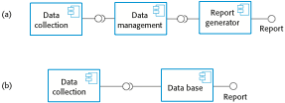
Figure 17.15 Data collection and report generation components

